Slide 1
Predicting Iron Content in Iron Ore Using Machine Learning
Presented by Supervision under
Abhiraj Rana (BTECH/10059/21) Dr. Sudip Kumar Sahana
Shashank Raj (BTECH/10075/21)

Slide 2
Objective
The objective of this project is to develop and evaluate a machine learning model capable of accurately identifying iron ore samples based on their iron concentration and impurity levels. Utilizing various regression algorithms, the goal is to create a predictive model that enhances the efficiency and accuracy of identifying iron ore quality. By leveraging machine learning techniques, this work aims to contribute to optimizing mineral processing workflows, thereby supporting informed decision-making and improving operational efficiency in the iron production industry.

Slide 3
Motivation
The motivation behind this project stems from the critical need within the iron production industry to reliably and efficiently assess the quality of iron ore. Traditional methods of analyzing ore samples are often time-consuming and resource-intensive. By employing machine learning techniques, this project seeks to streamline the process of identifying iron ore with precise measurements of iron concentration and impurities. Such advancements not only contribute to operational cost reduction and process optimization but also pave the way for sustainable practices in mineral resource management. Ultimately, this work aims to empower stakeholders with data-driven insights that enhance decision-making capabilities and foster continuous improvement in iron ore processing technologies.

Slide 4
Contents
Mining
Iron Ore Mining
Floating Process
Machine Learning Model

Slide 5
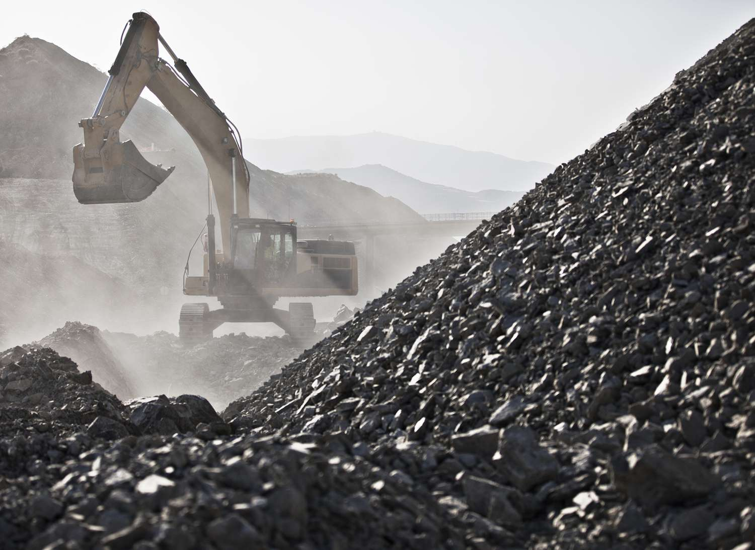
Mining
figure1

Slide 6
Mining steps
Extraction of Resource: Extraction of resources in mining involves the removal of valuable minerals or other geological materials from the earth. This process includes identifying and surveying potential sites, drilling, blasting, and transporting the extracted materials for processing and refinement.
Techniques and Methods: Mining techniques include surface mining (open-pit, strip mining) and underground mining (shaft mining, drift mining). Methods also involve hydraulic mining, dredging, and room and pillar mining, each selected based on the resource's location, depth, and economic viability.
Economic Importance: Mining is economically vital, providing raw materials for various industries, including construction, technology, and manufacturing. It generates employment, contributes to GDP, and fosters regional development. Minerals like coal, iron, and gold are crucial for energy, infrastructure, and currency.

Slide 7
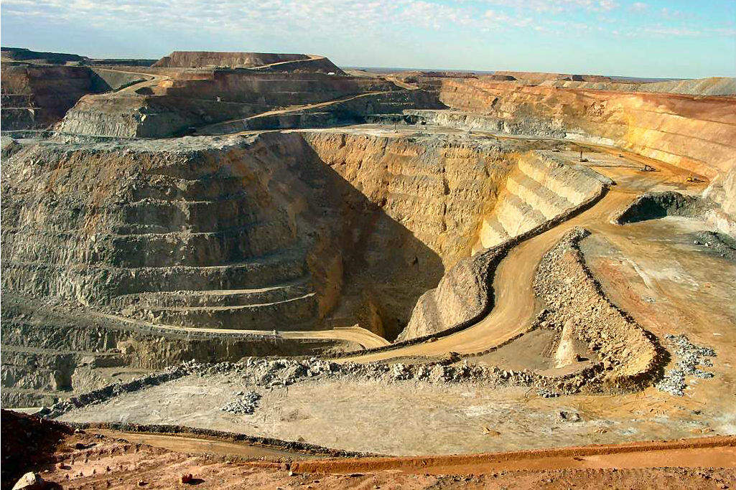
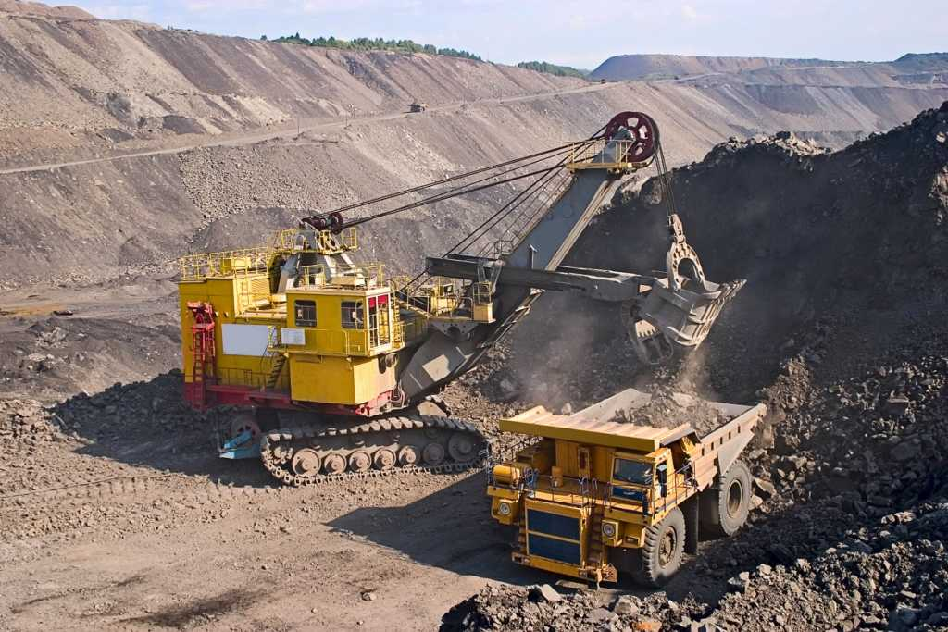
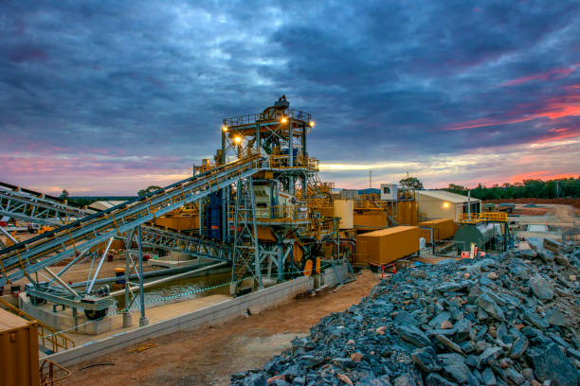
Environmental Impact: Mining significantly impacts the environment, causing deforestation, habitat destruction, soil erosion, water pollution, and air pollution. The disturbance of ecosystems and contamination of water sources with heavy metals and chemicals are critical concerns requiring mitigation measures and sustainable practices.
Technological Advancements: Technological advancements in mining enhance efficiency, safety, and environmental protection. Innovations include automation, drones for site surveys, advanced drilling techniques, real-time monitoring, and data analytics. These technologies reduce operational costs, increase precision, and minimize environmental footprint.
figure2
figure3
figure4

Slide 8
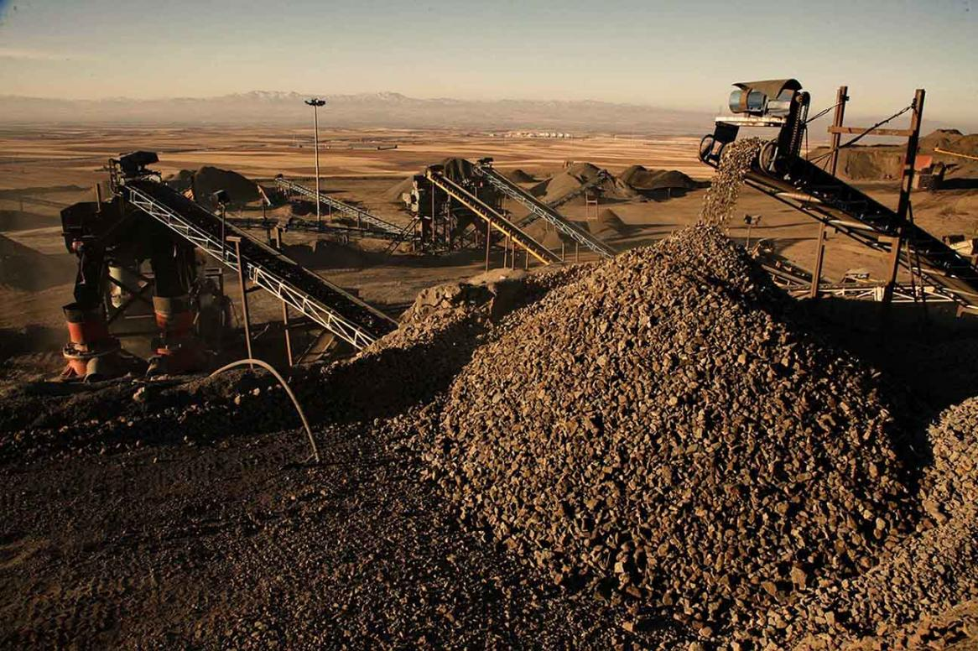
Iron Ore Extraction
figure5

Slide 9
Iron Ore Mining
Resource Extraction: Iron ore mining involves the extraction of iron-bearing minerals from the Earth's crust. These minerals include hematite, magnetite, siderite, limonite, or taconite, which are mined for their iron content.
Mining Methods: Iron ore is typically extracted through open-pit mining or underground mining methods, depending on the depth of the deposit and its geological characteristics. Open-pit mining involves removing overburden (soil and rock) to access the ore body, while underground mining accesses ore through tunnels and shafts.
Processing and Beneficiation: Once extracted, iron ore undergoes processing to remove impurities and increase its iron content. This process, known as beneficiation, involves crushing, screening, washing, magnetic separation, and flotation to produce a concentrate suitable for steelmaking.

Slide 10
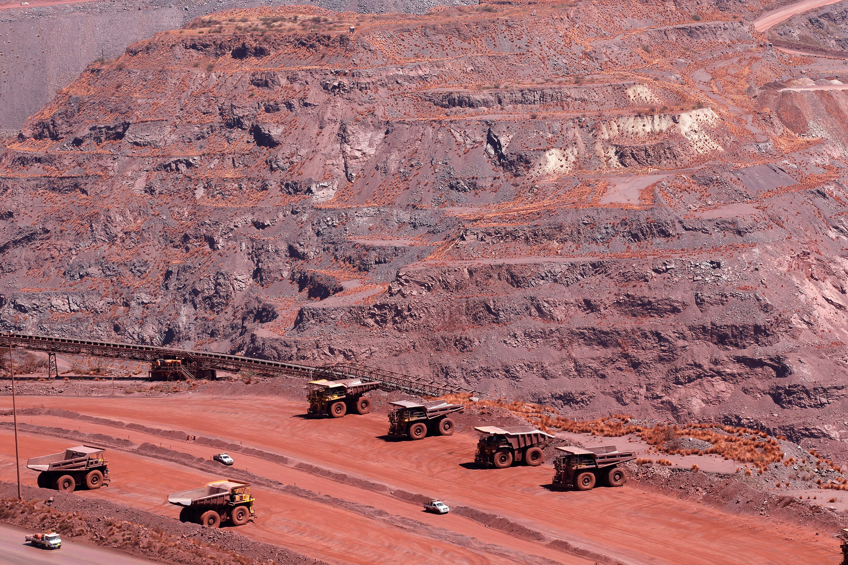
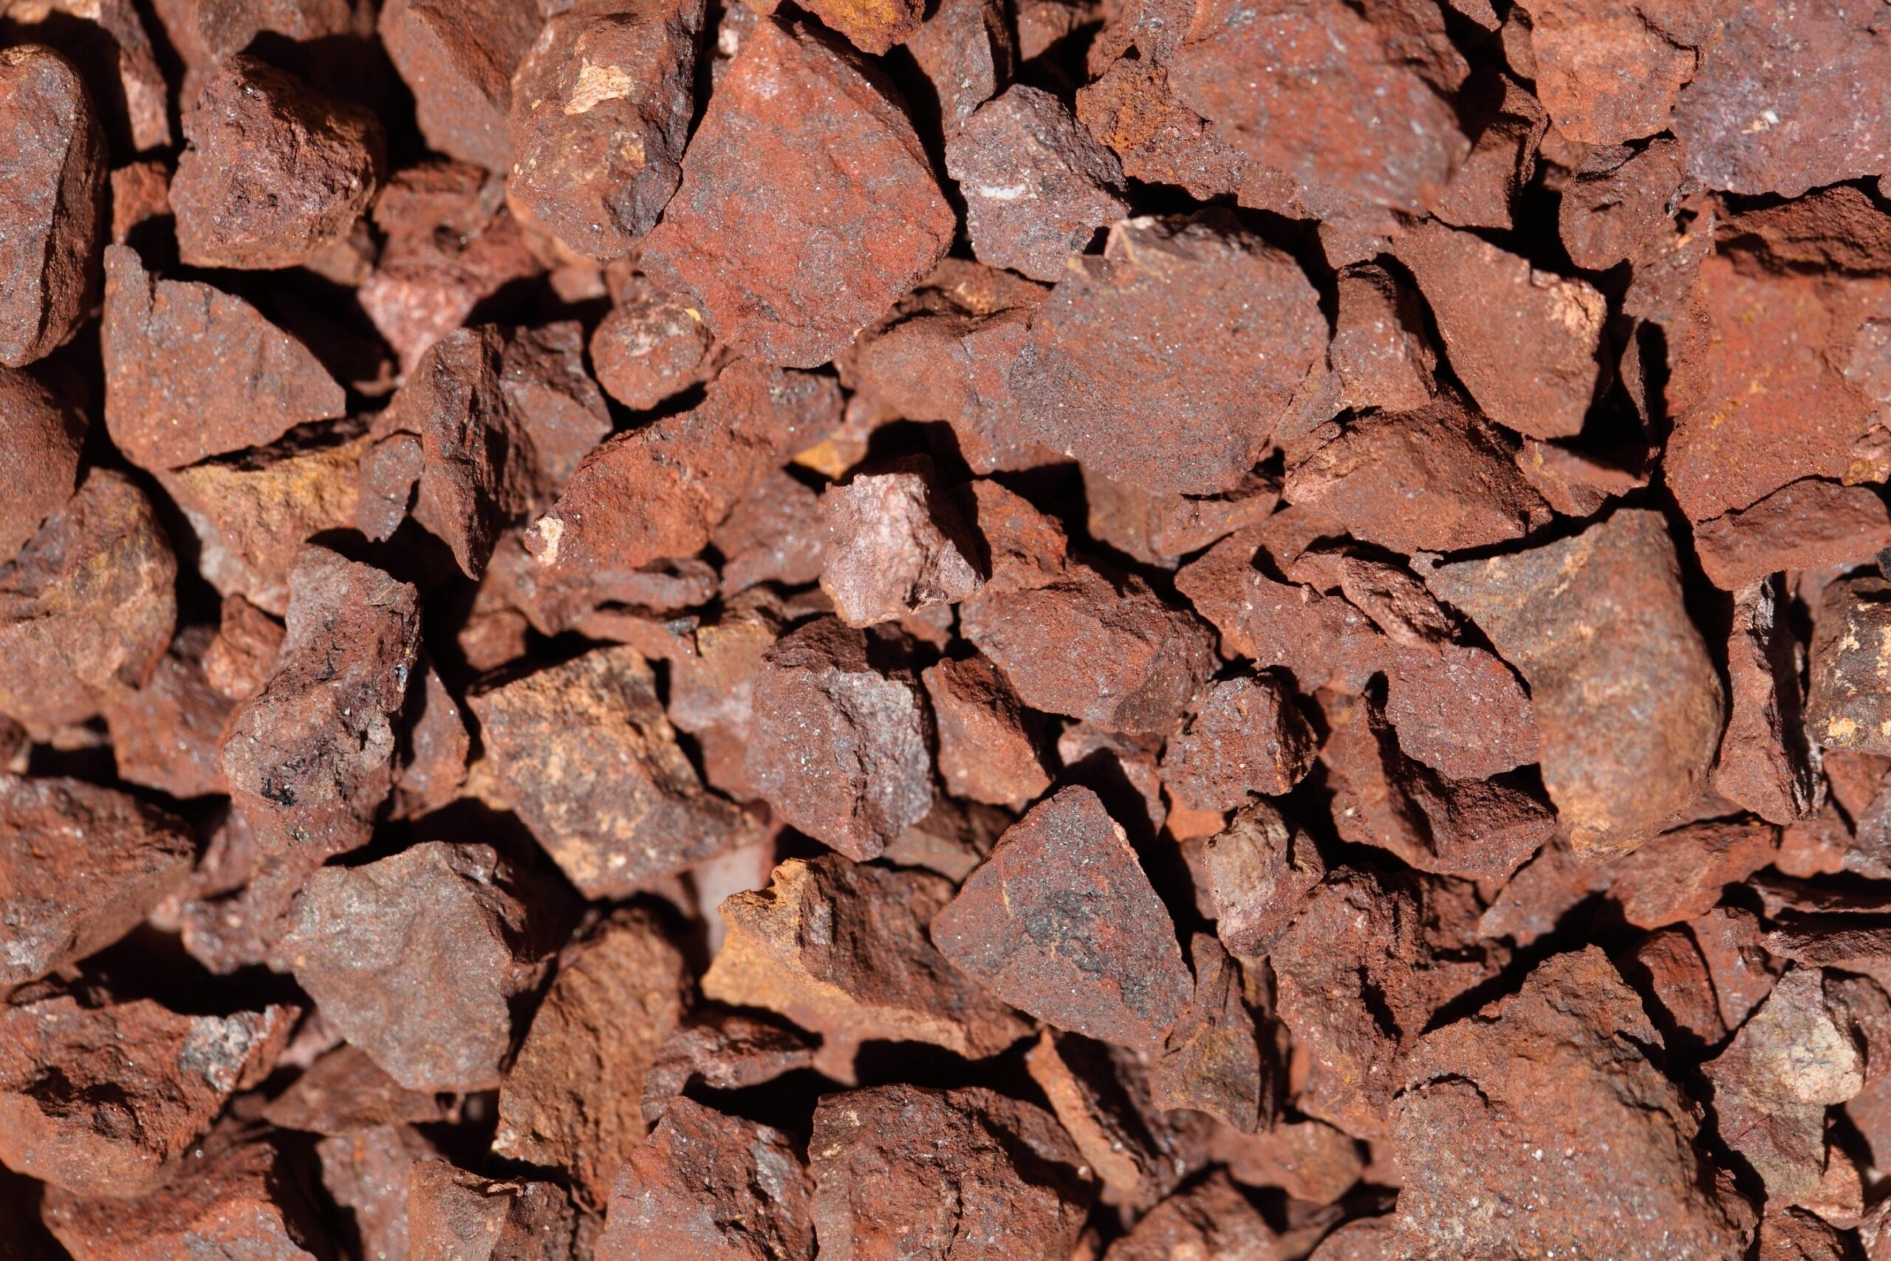
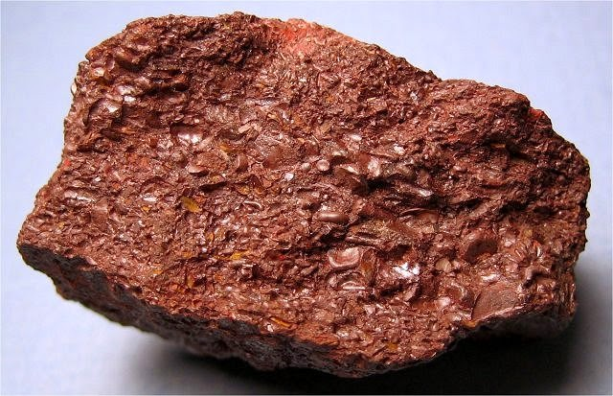
Global Production: Iron ore is essential for the steel industry, with major producers being Australia, Brazil, China, India, and Russia. These countries lead in global iron ore production due to their vast reserves and highly efficient mining operations, ensuring a steady supply of this critical commodity to meet global demand.
Market Influence: Iron ore prices are shaped by global demand, economic trends, and geopolitical factors. The steel industry's health directly impacts iron ore demand, making it a cyclical market. Fluctuations in industrial production and construction activities worldwide significantly influence the market dynamics of iron ore.
figure6
figure7
figure8

Slide 11
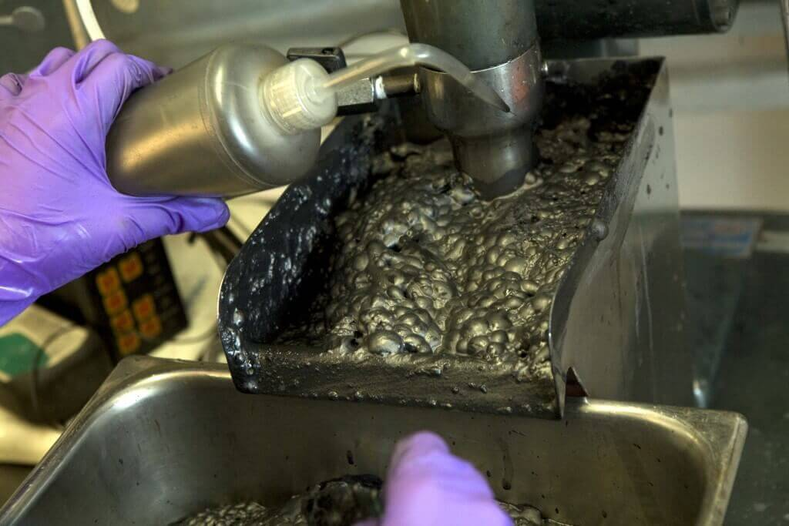
Floating Process
figure9

Slide 12
Floating Process
The floating process in iron ore mining, also known as froth flotation, is a method used to separate fine particles of minerals from unwanted gangue. Here’s an overview of the floating process in iron ore mining:
Ore Preparation: The mined iron ore is crushed into small pieces and ground to a fine powder. This step prepares the ore for the flotation process by increasing the surface area for chemical reactions.
Conditioning: The finely ground ore is mixed with water and chemical reagents in flotation tanks. The reagents, known as collectors, attach themselves to the surfaces of the desired mineral particles (iron-bearing minerals), making them hydrophobic (repel water).
Flotation: Air bubbles are introduced into the flotation tanks. The hydrophobic mineral particles adhere to the air bubbles and float to the surface of the tank, forming a froth layer. This froth, which contains the valuable minerals, is skimmed off while the gangue (unwanted minerals and impurities) sinks to the bottom.

Slide 13
Separation: The froth containing the iron-bearing minerals is collected and further processed to produce a concentrate with high iron content. This concentrate is then filtered, dried, and transported for further processing in steel production.
Tailings: The gangue material that sinks to the bottom of the flotation tanks, known as tailings, is often disposed of in tailings ponds or returned to the mined area. Efforts are made to manage tailings responsibly to minimize environmental impact.
Control and Optimization: The flotation process is controlled and optimized through monitoring and adjusting parameters such as pH, reagent dosage, air flow rate, and froth depth. This ensures maximum recovery of valuable minerals and efficient operation.
The flotation process is widely used in iron ore mining and other mineral processing industries because it allows for the selective separation of minerals based on their physical and chemical properties. It is crucial for producing high-grade iron ore concentrates that are essential for steelmaking and various industrial applications.

Slide 14
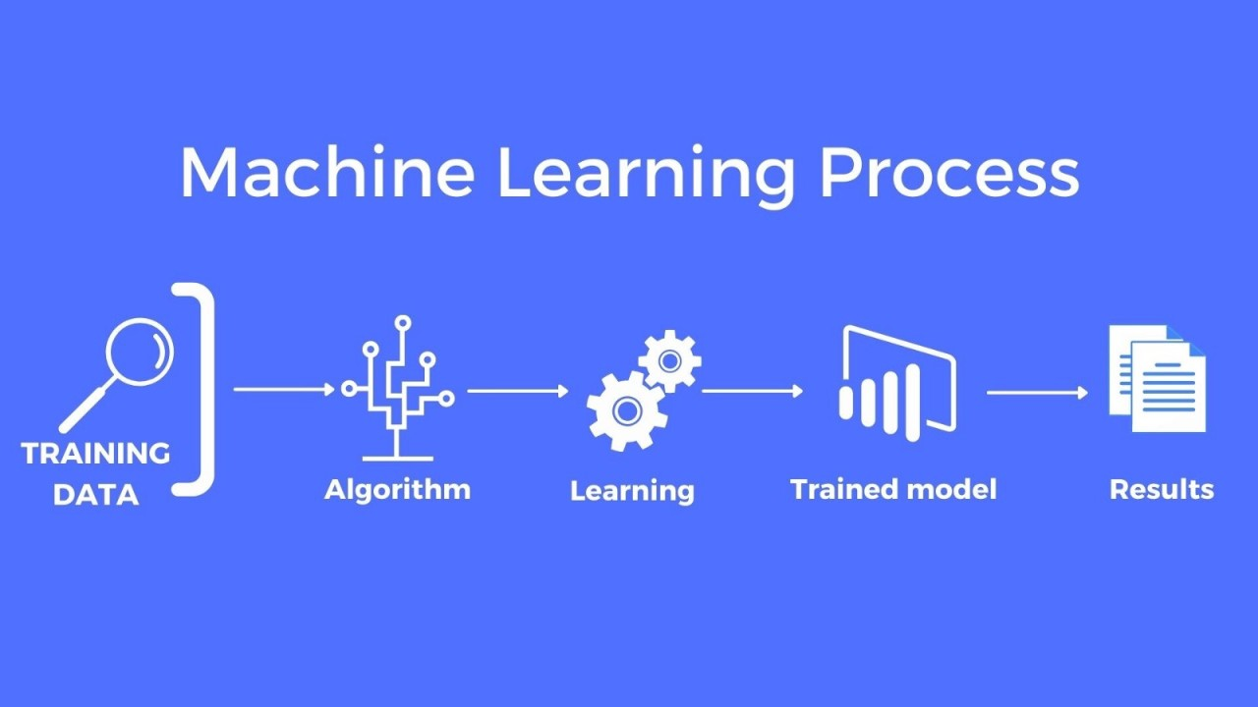
Machine Learning Model
figure10

Slide 15
Steps for Machine Learning Model
Data Cleaning
Step 2
Regression Algorithm
(training& testing)
Step 3
ML Model
Step 1

Slide 16
Data Cleaning
Loading Data: Data is loaded from file_name.csv, parsed with dates, and decimals specified as commas.
Removing Negative Values: Filtering out rows where any numeric column (except the first as it has dates) has values greater than zero removes negative values.
Removing Outliers: Outliers are identified and removed based on their Z-scores, focusing on values beyond 2 standard deviations from the mean.
Dropping Unnecessary Columns: Columns like % Iron Concentrate are dropped due to redundancy or high correlation with other features, while additional columns are removed based on their correlation with the target variable and distribution.
Feature Engineering: New features are engineered by aggregating related columns, such as averaging air flow features and level data.
Final Data Cleaning: The dataframe undergoes final cleaning steps, including dropping the original columns used for feature engineering and reordering columns for clarity.

Slide 17
Regression Algorithms
5 Types of Regression Algorithms are used in ML model
Linear Regression
Ridge Regression
Lasso Regression
K-Nearest Neighbors Regressor (KNN)
Decision Tree Regressor

Slide 18
Linear Regression: Linear regression models the relationship between dependent and independent variables by fitting a linear equation to the observed data, aiming to minimize the difference between predicted and actual values.
Ridge Regression: Ridge regression adds a penalty term to the linear regression model to prevent overfitting by penalizing large coefficients, promoting simpler models with better generalization ability.
Lasso Regression: Similar to Ridge regression, Lasso adds a penalty to the regression model but uses the L1 norm penalty, which encourages sparsity by driving some coefficients to zero, thus performing variable selection alongside regularization.
K-Nearest Neighbors Regressor (KNN): KNN predicts the value of a new data point by averaging the values of its k nearest neighbors in the training dataset, making it a non-parametric and instance-based learning algorithm.
Decision Tree Regressor: Decision trees recursively split the data based on feature attributes to predict the target variable, optimizing splits to minimize variance in continuous target variables.

Slide 19
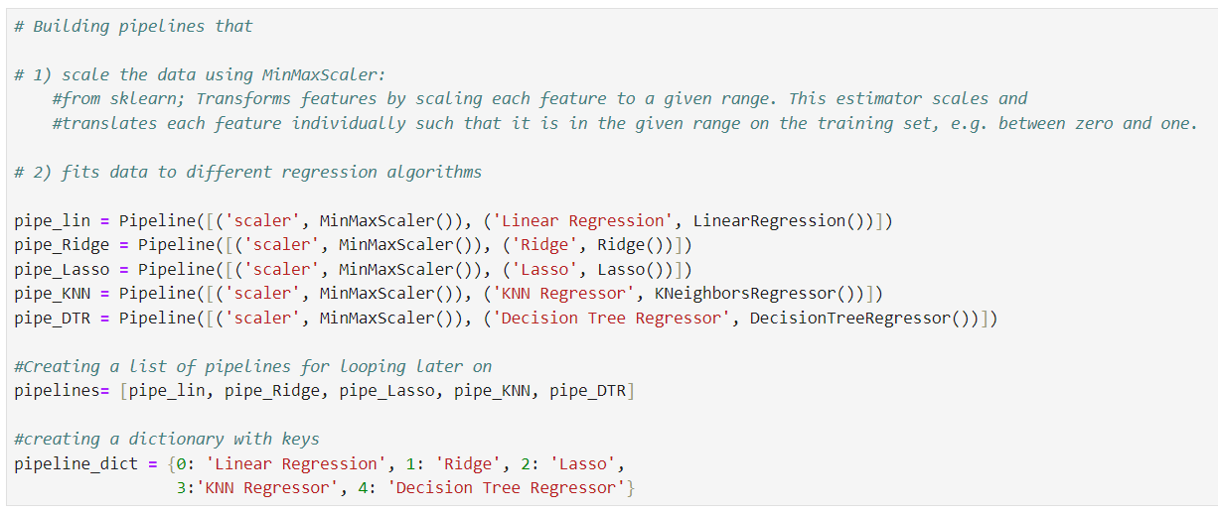
The code constructs pipelines that scale data using `MinMaxScaler` and fit it to different regression models: Linear Regression, Ridge, Lasso, K-Nearest Neighbors Regressor, and Decision Tree Regressor. These pipelines streamline preprocessing and model training, making it easy to apply and evaluate multiple regression algorithms on the same dataset. A dictionary maps each pipeline to its respective regression model name for organized reference.

Slide 20
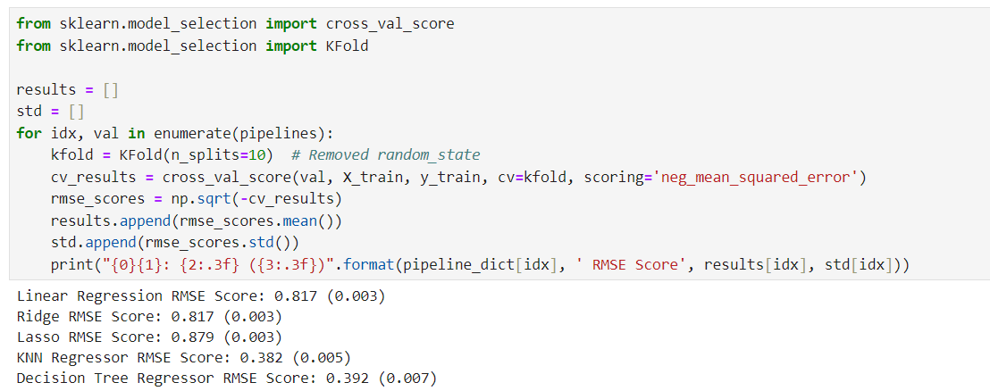
The code evaluates different regression models using 10-fold cross-validation on the training data. For each pipeline, it calculates the root mean squared error (RMSE) scores and their standard deviations. The results, showing the average RMSE and its standard deviation for each model, are printed for comparison.

Slide 21
Accuracy
We divided our dataset into two distinct subsets, utilizing a 70-30 split ratio for training and testing purposes in our machine learning model. This strategic partitioning ensures that 70% of the data is dedicated to training the model, allowing it to learn patterns and relationships within the dataset. The remaining 30% is set aside for testing the model's performance on unseen data, providing a reliable assessment of its predictive capabilities.
Following the training phase, we evaluated the model's effectiveness by measuring two critical metrics: average error and accuracy. The average error quantifies the typical magnitude of differences between the model's predictions and the actual values in the test dataset. This metric is crucial for understanding the model's precision in numerical predictions. Meanwhile, accuracy represents the model's overall performance in correctly predicting outcomes relative to the actual data. It is calculated as a percentage, where higher values indicate a stronger alignment between predicted and observed values.

Slide 22
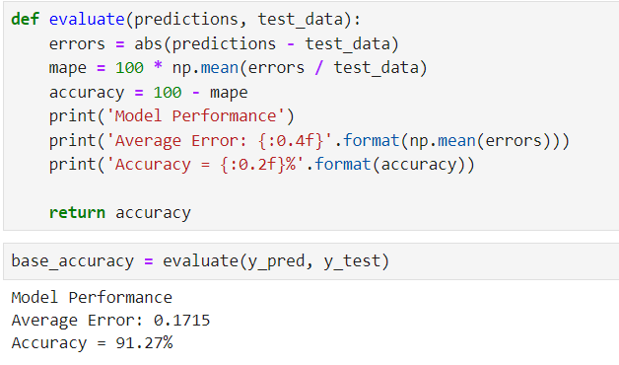

Slide 23
Conclusion
The project on optimizing silica prediction in iron ore through machine learning represents a pivotal advancement for the mining sector. By refining silica removal processes, it not only promises to cut down on operational expenses and production timelines but also sets a precedent for leveraging cutting-edge technology in mineral extraction. With continued data augmentation, the model stands to achieve heightened precision, marking a transformative step towards sustainable mining practices in the future.

Slide 24
References
1.Image reference
figure 1: https://www.investopedia.com/ask/answers/040615/what-metals-and-mining-sector.asp
figure 2: https://www.mining-technology.com/features/future-of-mining-industry-predictions/
figure 3: https://corporatefinanceinstitute.com/resources/valuation/mining-asset-valuation-techniques/
figure 4: https://www.thermofisher.com/blog/mining/how-to-improve-mining-and-mineral-operations-heres-a-guide/
figure 5: https://financialtribune.com/articles/economy-business-and-markets/27328/chadormalu-iron-ore-extraction
figure 6: https://www.reuters.com/markets/commodities/anglo-americans-kumba-iron-ore-profit-falls-weaker-prices-2023-07-25/
figure 7: https://www.theassay.com/articles/the-assay-insights/the-assay-guide-to-iron-ore/
figure 8: https://geologylearn.blogspot.com/2015/03/iron-ore.html
figure 9: https://camachem.com/pt/blog/post/froth-flotation
figure 10: https://www.linkedin.com/pulse/building-machine-learning-model-from-scratch-luis-soares-m-sc-/

Slide 25
2.Content reference
https://education.nationalgeographic.org/resource/mining/
https://www.britannica.com/technology/iron-processing/Ores
https://www.sciencedirect.com/topics/earth-and-planetary-sciences/flotation-froth
https://www.onlinemanipal.com/blogs/popular-regression-algorithms-in-machine-learning

